Slide 1


Optimization of Campaign Budget Allocation using Genetic Algorithms
Team: Green Minds
Shritej Shrikant Chavan, Shaurya Tripathi,
Shashank Ravishankar,
Shaiba Jhunjhunwala, Sarthak Vajpayee

Slide 2


Digital Marketing
$800 billion industry by 2027
Importance of Prudent Decision making in Budget Allocation
Role of Data Science and Statistical Modelling

Slide 3
Problem Statement
$1M of budget to Ad Campaign
Distributed across 3 Digital Channels and 5 Audience types
Optimize the Budget while Maximizing Digital Engagement
Business Constraint - Minimum of 2% and maximum of 50% Total Spend

Slide 4
Data
5 Ad Campaigns consisting of $ Spend for 375000 ads across different Channels, Audiences, Content for 90 days
Success Metrics – Impressions, Clicks, Video Views, Web Visits, Social Likes
Digital Engagement – Click-through Rate = Clicks/Impressions

Slide 5

Formulation
Regression: Independent Variables and Dependent Variables ?
$Impressions= β_{0}+ β_{1}Channel+ β_{2}Audience+ β_{3}Spend$*
$Clicks= β_{0}+ β_{1}Channel+ β_{2}Audience+ β_{3}Spend$*
$CTR_{ij}=\frac{Predicted Clicks}{Predicted Impressions}=\frac{f\left(Spend_{ij}\right)}{g\left(Spend_{ij}\right)}=h\left(Spend_{ij}\right)$
Tree-Based Ensemble Regression approach. Why?
Objective Function: $max \sum_{i, j}^{3, 5}{CTR_{ij} =\sum_{i, j}^{3, 5}{h(Spend_{ij})}}$
Non-Linear, non-differentiable objective function.
Notes:
*Even though the Equations are Linear, they are demonstrated for simplicity of understanding

Slide 6
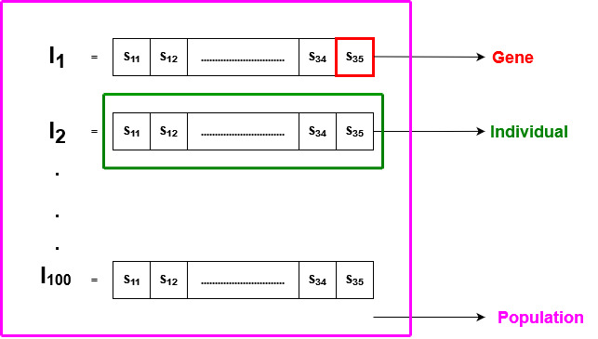
Genetic Algorithms
% Spend (Sij),
i – Digital Channel - [1, 2, 3]
j – Audience Type – [1, 2, 3, 4, 5]

Slide 7


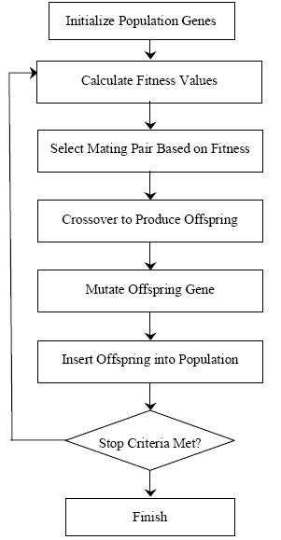
Genetic Algorithm
Overview

Slide 8
Results
 | Audience 1 | Audience 2 | Audience 3 | Audience 4 | Audience 5 | Total
Programmatic | 2% | 3% | 12% | 3% | 2% | 22%
Search | 17% | 2% | 2% | 2% | 15% | 38%
Social | 2% | 14% | 20% | 2% | 2% | 40%
Total | 21% | 19% | 34% | 7% | 19% | 100%
Fitness Value - 8.244
Notes:
XGB Regressor (R²) - 0.7343 , Max Fitness Value - 8.2446

Slide 9
Conclusions
Genetic algorithms were used to allocate advertising budgets across various channels and audience types based on average CTRs
Highest spending budget of 20% was allocated to Social, Audience 3 with the highest average CTR & lowest spend of 2% was allocated to Programmatic, Audience 5 with the lowest CTR
Tree-based Regression approach was used to predict digital engagement metric - Click-through Rate (CTR)

Slide 10
Limitations and Future Work
Metrics for Campaign return – More robust metric to quantify campaign return. Examples Conversion Rate, Pay-per-Click, Impressions or some weighted combinations of all the above.
Feature Engineering- Lack of feature engineering to create more meaningful features to better predict our regression model
Tune Hyper-parameters – Tune hyperparameters for regression as well as genetic algorithms.
Fitness Function – Define fitness function as weighted sum of some metric for campaign return rather than plain sum

